Slide 1
Scores and Admissions
Mbonisi and Rick

Slide 2
Data Aquisition
knitr::opts_chunk$set(echo = TRUE) library(tidyverse) library(readxl) library(xlsx) library(datadictionary) data = read.csv("adm2021.csv") dictData = read_xlsx("adm2021Dict.xlsx", sheet=2) dict = data.frame(dictData$varname, dictData$varTitle) names(data) <- dict$dictData.varTitle[match(names(data), dict$dictData.varname)] #write.xlsx(data, file = "appendedData.xlsx", sheetName="Colleges")
Creating the final data set with only the chosen variables.
##Data Acquitision 2
colleges = select(data,'Unique identification number of the institution') colleges <- cbind(colleges,select(data,'ACT Composite 75th percentile score'),select(data,'Secondary school GPA'),select(data,'Completion of college-preparatory program'),select(data,'TOEFL (Test of English as a Foreign Language'),select(data,'Enrolled total'),select(data,'Percent of first-time degree/certificate-seeking students submitting ACT scores'),select(data,'SAT Evidence-Based Reading and Writing 75th percentile score'),select(data,'SAT Math 75th percentile score')) colleges <- colleges %>% rename("ID" = "Unique identification number of the institution", "ACT" = "ACT Composite 75th percentile score", "GPA" = "Secondary school GPA", "CollegePrep" = "Completion of college-preparatory program", "TOEFL" = "TOEFL (Test of English as a Foreign Language", "NumberEnrolled" = "Enrolled total", "ACTPercentage" = "Percent of first-time degree/certificate-seeking students submitting ACT scores", "SATWR" = "SAT Evidence-Based Reading and Writing 75th percentile score", "SATM"= "SAT Math 75th percentile score") colleges = drop_na(colleges) write.xlsx(colleges, file = "Colleges.xlsx", sheetName="Colleges")
This marks the end of house keeping data cleaning.

Slide 3
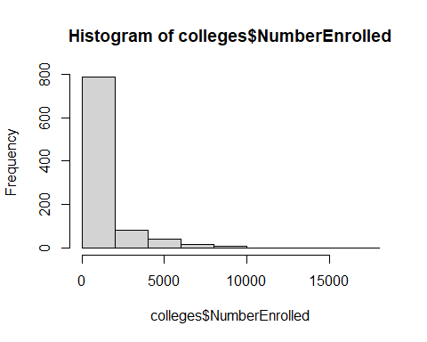
Data Cleaning
We know that ‘NumberEnrolled’ is skewed.
hist(colleges$NumberEnrolled)

Slide 4
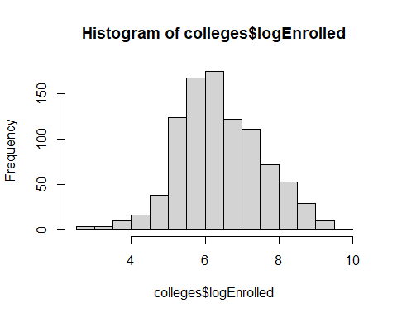
colleges$logEnrolled <- (log(colleges$NumberEnrolled)) hist(colleges$logEnrolled)

Slide 5
First order model
model1 = lm(colleges$ACT ~ colleges$logEnrolled + colleges$ACTPercentage + colleges$SATWR + colleges$SATM + colleges$GPA + colleges$CollegePrep + colleges$TOEFL) summary(model1)
## ## Call: ## lm(formula = colleges$ACT ~ colleges$logEnrolled + colleges$ACTPercentage + ## colleges$SATWR + colleges$SATM + colleges$GPA + colleges$CollegePrep + ## colleges$TOEFL) ## ## Residuals: ## Min 1Q Median 3Q Max ## -7.8266 -0.8621 0.0407 0.9152 6.9328 ## ## Coefficients: ## Estimate Std. Error t value Pr(>|t|) ## (Intercept) -6.559656 0.677665 -9.680 < 2e-16 *** ## colleges$logEnrolled 0.146133 0.054269 2.693 0.00721 ** ## colleges$ACTPercentage -0.006137 0.002136 -2.873 0.00415 ** ## colleges$SATWR 0.027413 0.002357 11.633 < 2e-16 *** ## colleges$SATM 0.024996 0.002054 12.168 < 2e-16 *** ## colleges$GPA 0.038105 0.068181 0.559 0.57638 ## colleges$CollegePrep -0.093519 0.057593 -1.624 0.10476 ## colleges$TOEFL 0.047627 0.048139 0.989 0.32273 ## --- ## Signif. codes: 0 '***' 0.001 '**' 0.01 '*' 0.05 '.' 0.1 ' ' 1 ## ## Residual standard error: 1.726 on 929 degrees of freedom ## Multiple R-squared: 0.8151, Adjusted R-squared: 0.8137 ## F-statistic: 585.2 on 7 and 929 DF, p-value: < 2.2e-16

Slide 6
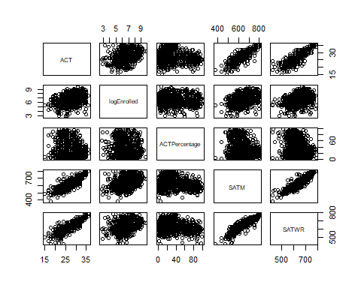
First Order Model Summary
Significant predictors: logEnrolled, ACTPercentage, SATWR and SATM.
There SAT scores (dis aggregated by subjects) and the percentage of students who choose to submit their ACT scores.
numerical = cbind(ACT = colleges$ACT, logEnrolled = colleges$logEnrolled, ACTPercentage = colleges$ACTPercentage, SATM = colleges$SATM, SATWR = colleges$SATWR) pairs(numerical)

Slide 7
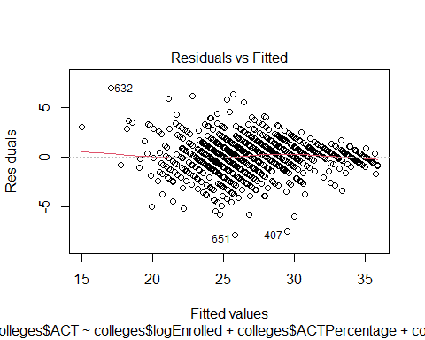
##First Order Model Continued
plot(model1)

Slide 8
Resid / Fitted Plot shows no concerning curvature. Cook’s Distance none greater than 0.5

Slide 9
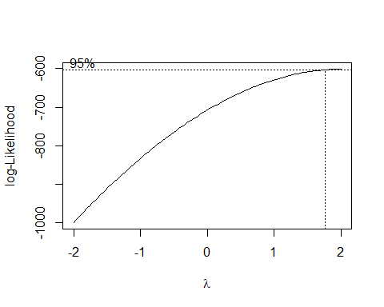
Box Cox
library(MASS)
## ## Attaching package: 'MASS'
## The following object is masked from 'package:dplyr': ## ## select
bc = boxcox(model1)

Slide 10
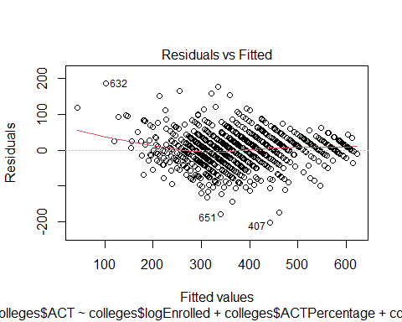
lambda = bc$x[which.max(bc$y)] cat(lambda)
## 2
##Box Cox Fix Since Lambda = 2, therefore we run a quick fix.
colleges$ACT = ((colleges$ACT^lambda-1)/lambda) model1BC = lm(colleges$ACT ~ colleges$logEnrolled + colleges$ACTPercentage + colleges$SATWR + colleges$SATM + colleges$GPA + colleges$CollegePrep + colleges$TOEFL) summary(model1BC)
## ## Call: ## lm(formula = colleges$ACT ~ colleges$logEnrolled + colleges$ACTPercentage + ## colleges$SATWR + colleges$SATM + colleges$GPA + colleges$CollegePrep + ## colleges$TOEFL) ## ## Residuals: ## Min 1Q Median 3Q Max ## -200.809 -24.035 1.627 24.253 185.687 ## ## Coefficients: ## Estimate Std. Error t value Pr(>|t|) ## (Intercept) -545.21233 17.68070 -30.837 < 2e-16 *** ## colleges$logEnrolled 3.40279 1.41591 2.403 0.01645 * ## colleges$ACTPercentage -0.19497 0.05573 -3.499 0.00049 *** ## colleges$SATWR 0.68324 0.06148 11.112 < 2e-16 *** ## colleges$SATM 0.75212 0.05360 14.033 < 2e-16 *** ## colleges$GPA 3.01139 1.77889 1.693 0.09082 . ## colleges$CollegePrep -2.21597 1.50263 -1.475 0.14063 ## colleges$TOEFL 1.22971 1.25597 0.979 0.32779 ## --- ## Signif. codes: 0 '***' 0.001 '**' 0.01 '*' 0.05 '.' 0.1 ' ' 1 ## ## Residual standard error: 45.03 on 929 degrees of freedom ## Multiple R-squared: 0.8321, Adjusted R-squared: 0.8308 ## F-statistic: 657.5 on 7 and 929 DF, p-value: < 2.2e-16
Significant predictors: logEnrolled, ACTPercentage, SATWR and SATM, and now GPA!
##Resid Analysis on BC Fix
plot(model1BC)

Slide 11
Fat Tailed Q-Q.
##Step-wise

